Slide 1
Reduce
Reduce:
Replace each prime by a smaller cube contained in it.
| F | = |F| after reduce
Since some of cubes of F are not prime, Expand can be applied to F to yield a different cover that may have fewer cubes.
| F | < |F| after Expand
Move from locally optimal solutions to a better one.

Slide 2
Reduce
Gives two possibilities for decreasing the size of cover
- The reduced cube can be covered by a
neighboring cube after the EXPAND.
- The reduced cube can expand in different
direction to cover some neighboring cube.

Slide 3







Reduce
Definition:
Smallest cube is a cube containing all
minterms in not covered by D and
= smallest cube containing ( )
=
is still a cover.

Slide 4



Reduce
C_{i} =
SCC(C_{i}
F(i)’ )
?= SCC(C_{i})
SCC(F(i)’)
?= C_{i}
SCC(F(i)’)
x
Ex:
F = C₁ + C₂
F(1) = F - C₁= C2
SCC(F(1)’) = 1
c₁
c₂
C₁
1 = C₁
But,
SCC(C₁
F(1)’ ) = a single vertex x
so C₁
SCC(F(1)’ )
SCC(C₁
F(1)’ )

Slide 5



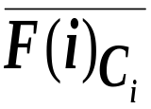
Reduce
= SCC(C_{i}
) = C_{i}
SCC( )
SCC( )
1. Complementation
2. Smallest cube containing problem
=> Find a cube containing the complement
  of a cover

Slide 6

Find a Cube Containing the Complement of a Cover
Proposition : The smallest cube c containing the complement of a cover F, F 1, satisfies
I(C)_{i} = 0 if x_{i}
1 if x_{i}’
2 otherwise

Slide 7
Reduce
F
F
x_{i} = 0
x_{i} = 1
x_{i} = 0
x_{i} = 1
(c)_{i} = 0
(c)_{i} = 2
F
x_{i} = 0
x_{i} = 1
(c)_{i} = 1
For general function, the above test employ
difficult covering test. However, if it is a unate
function, all test can be done easily.

Slide 8



Reduce
Proposition : Let F be a unate cover. Then x_{i}
F
if and only if there exists a cube, c_{i} F, such that
I(x_{i})
I(c_{k})
pf : A single output unate cover contains all
primes of that function.

Slide 9


Reduce
ex:
x₁ x₂ x₃
F 2 1 2
2 2 0
Find the smallest cube containing F’.
x₁
F
x₁’
F
c₁ = 2
x₂
F
c₂ = 0
x₃ ’
F
c₃ = 1
= ( 2 0 1)

Slide 10

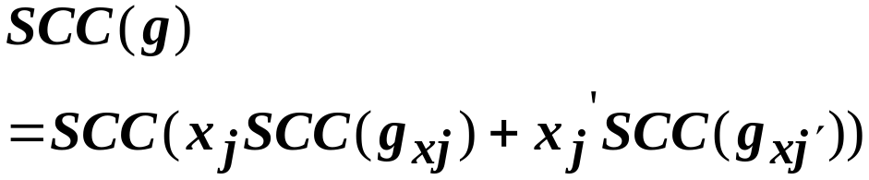

Smallest Cube Containing Problem
Let
R-merge
Let a and b be two cubes. Then, the smallest cube C containing {a, b} is
a b , where denotes the coordinate wise union.
ex: a = 0 1 2 1
b = 1 1 2 0
a
b= 2 1 2 2

Slide 11
Reduce
ex:
F = 2 2 2 0
1 2 1 2
1 1 2 2
0 0 2 2
0 2 1 2
reduce C₁ = 2 2 2 0
F(1) = 1 2 1 2
1 1 2 2
0 0 2 2
0 2 1 2
F(1)_{C1} = 1 2 1 2
1 1 2 2
0 0 2 2
0 2 1 2

Slide 12


Reduce
1 2 1 2
1 1 2 2
0 0 2 2
0 2 1 2
{2 2 0 2} = SCC(F(1)_{C1}’ )
{0 1 0 2}
{1 0 0 2}
x₁’
x₁
2 0 2 2
2 2 1 2
2 2 1 2
2 1 2 2
x₁’ {2 1 0 2}
x₁ {2 0 0 2}
= SCC( )
c₁
= 2 2 0 2
2 2 2 0
= 2 2 0 0

Slide 13
Reduce
order dependent
  reduce the largest cube
  reduce those cubes that are nearest to it.
compute pseudo distance
  (the number of mismatch)
  Ex:
  0 1 0 1
  0 2 1 1 PD = 2

